Slide 1

Online Tutoring System
Database Design & Implementation
24th October 2022
Team Members
Waqas Ahmad Chaudhary | 20211178
Elisabeth Putri | 20000000

Slide 2

1
Context Diagram
2
DFD Level 0 Diagram
3
ERD
4
GRD
5
Implemented Database in SQL
Table of Content

Slide 3
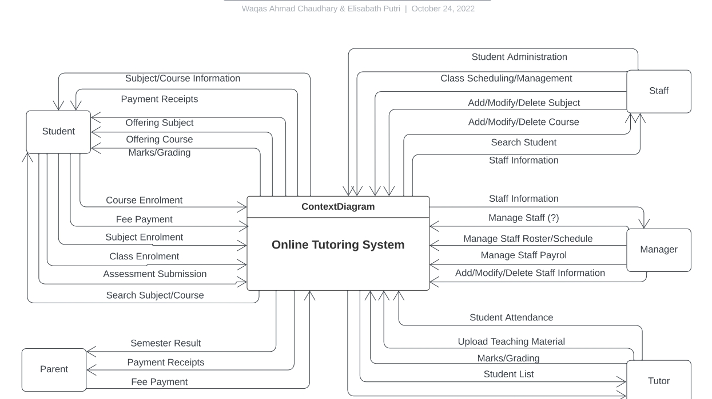
Context Diagram

Slide 4
DFD Level 0 Diagram

Slide 5
ERD

Slide 6
GRD

Slide 7
Implemented SQL

